Slide 1
Prompt Engineering

Slide 2
Outline
Prompt Engineering Intro
Prompt Types
Zero-shot & Multi-shot Prompting
Chain-of-thought prompting
Role Prompting & Persona Engineering
Constraints
Instructions & Guidelines
Interaction & Dialogue State
Fine-tuning Conditioning

Slide 3

Prompt Engineering Intro

Slide 4
Prompt Engineering
When writing traditional code, behavior is explicitly programmed and highly predictable.
With LLMs and Generative systems, the same underlying model can behave very differently, providing different outputs with slight changes to the given input (prompt).
Prompt Engineering is the practice of crafting inputs to an LLM in order to reliably get useful, accurate, and well-formed output.
The prompt itself should be something to design deliberately, rather than using the first phrasing that comes to mind
Prompt engineering is increasingly considered a core professional skill for developers working with LLMs, not a niche or optional specialty.
Think of it like knowing how to write an effective search query, a clear Git commit messages, or clear documentation.

Slide 5
Prompt Engineering
Prompt Engineering sits at the intersection of clear communication and understanding how the underlying model works.
Part of prompt engineering is anticipating how a model is likely to interpret and respond to different phrasings
Prompt engineering is not a one-time skill you master and set aside. It is an iterative practice.
Different tasks (coding, writing, analysis, classification) often call for different techniques.
A well-engineered prompt typically addresses several dimensions at once:
What you’re asking the model to do | The task itself
How you want it done | Format, style, constraints
Who the model should “be” while doing it | Role/Persona
What information it has to work with | Context/examples

Slide 6
Prompt Types

Slide 7
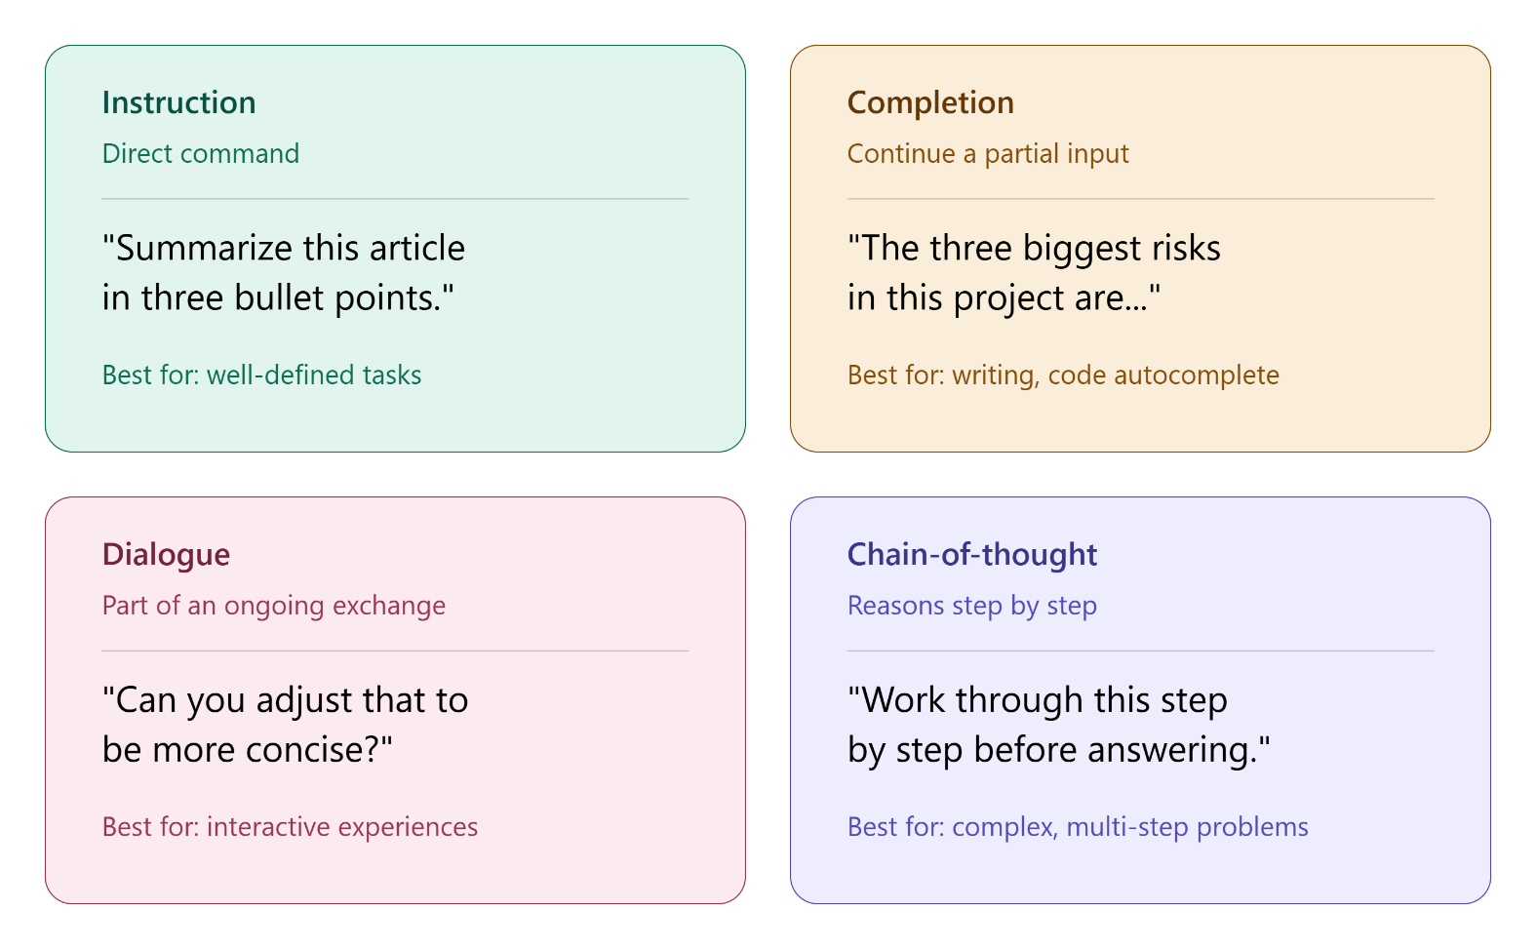
Prompt Types
Prompts can be categorized by their underlying structure and intent

Slide 8
Prompt Types
Instruction Prompts: A direct command or request telling the model what to do.
The most common prompt type for task-oriented work.
Completion Prompts: Providing a partial input and asking the model to continue or finish it, rather than issuing an explicit command.
Common in creative writing and code autocomplete.
Dialogue Prompts: Structured as back-and-forth conversation, where the model responds within an ongoing exchange, rather than to a single isolated request.
This is the default mode for chat-based tools like Claude.ai and ChatGPT
Chain-of-thought Prompts: Explicitly ask the model to reason through a problem step-by-step before producing a final answer, rather than jumping straight into a conclusion.
Best for complex tasks that may require referencing information or planning prior to completion

Slide 9
Prompt Types
Prompt types are not mutually exclusive
A single real-world prompt often blends multiple types, depending on the expected output
Recognizing prompt type matters, because different types suit different tasks:
Need specific, well-defined output? -> Instruction
Want natural continuation of existing code? -> Completion
Building an interactive experience? -> Dialogue
Solving something complex or multi-step? -> Chain-of-thought
As a developer, understanding these types helps you reason about how an AI feature is likely to behave.

Slide 10
Zero-Shot & Multi-Shot Prompting

Slide 11
Zero-shot Prompting
In prompt-engineering “shots” refer to the number of examples you include in your prompt to guide the AI’s output.
Zero-shot prompting: Asking a model to perform a task with no examples provided
Zero-shot prompting relies entirely on the trained-in knowledge of the LLM and instructions provided in the prompt
Tends to work well for common, well-understood tasks the model likely saw many similar examples of during training.
However…Instructions alone may be difficult to provide sufficient detail or may be more verbose than providing examples.

Slide 12
Few-Shot (multi-shot) Prompting
One-shot (single-shot) prompting: providing one example of the desired input/output patterns in the prompt
Multi-shot prompting: providing multiple examples (2+) of a desired pattern within the prompt
More examples establish the format, tone, or reasoning style expected.
Few-shot (typically 2-5 examples)
Many-shot (6+ examples)
Examples help reduce ambiguity about the exact expectations desired.
Example quality matters!
A small number of well-chosen, representative examples often outperforms a larger number of similar or redundant ones
Multi-shot prompting is usually worth the effort for:
unusual or highly specific formats
domain-specific classification schemes
Tasks with subtle edge cases
Anywhere consistency across many requests is vital

Slide 13
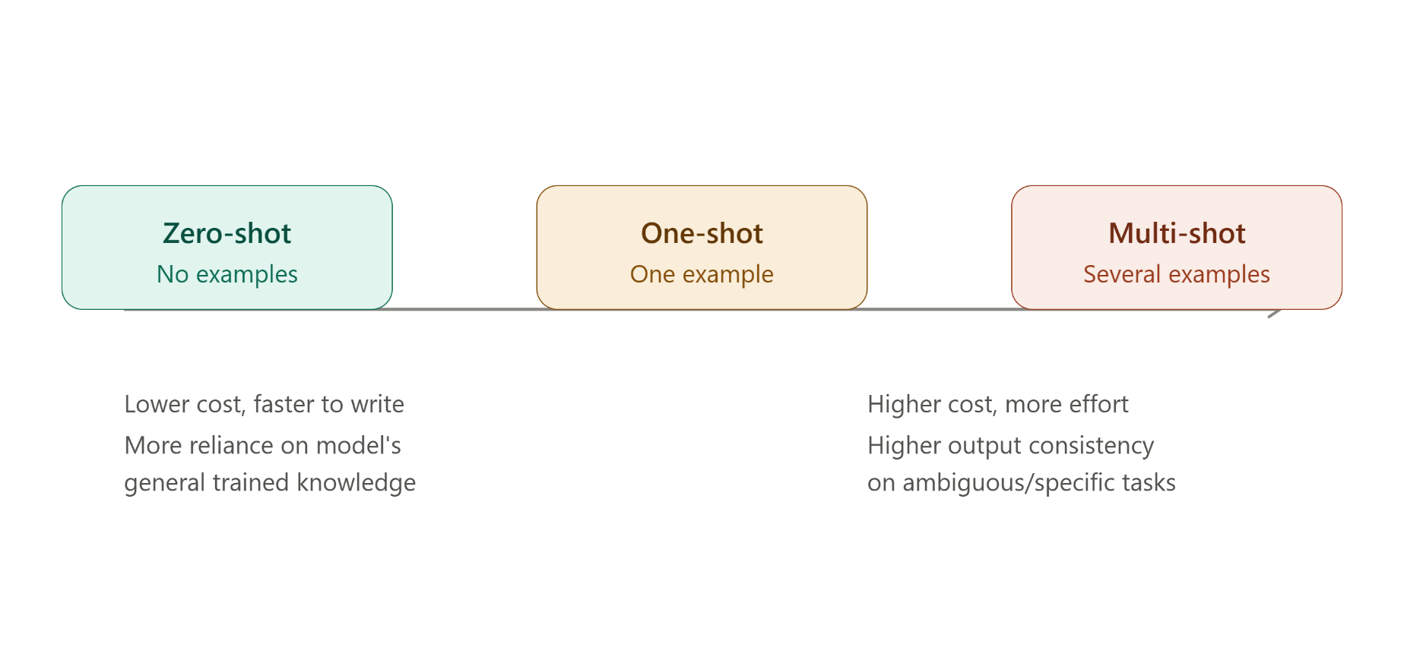
Few-Shot (multi-shot) Prompting
Keep in mind, all examples and instructions are given the same, single prompt.
Zero-shot vs Multi-shot prompting is a trade-off of cost, speed, accuracy and complexity

Slide 14
Chain of Thought Prompting

Slide 15
Chain of Thought (CoT) Prompting
Chain-of-Thought prompting asks a model to work through intermediate reasoning steps before producing a final answer, rather than jumping directly to a conclusion
Generating intermediate reasoning steps gives the model an opportunity to build toward a correct answer incrementally
Four common variants of Chain-of-thought prompting, in increasing order of how much structure is provided
Generic Zero-shot CoT
Structured (outlined) zero-shot CoT
Few-shot CoT
Structured (outlined) few-shot CoT

Slide 16
Generic Zero-shot CoT
Generic Zero-shot CoT: instructing the model to reason step-by-step, without specifying what the steps are or providing examples:
“Solve this math word problem. Think through it step-by-step before giving your final answer”
The model must execute multiple steps, and decide what those steps should be (this can vary by model training and the task in question)
This type of CoT prompt is the fastest to write, and incurs the lowest token cost.
Flexible across varied inputs.
Works well for common tasks.
Some AI models have a built-in ‘reasoning’ feature that may be activated which automatically enables a ‘planning’ or ‘thinking’ phase for any prompt provided.
By including CoT in your prompt, you control when the AI should or should not spend more time/resources thinking.

Slide 17
Structured Zero-shot CoT
Structured (outlined) zero-shot CoT: Explicitly prescribing the specific steps the model should follow.
The model must still execute each step; but doesn’t also have to decide what the steps are.
“Provide a thorough analysis of each student’s written report. First, read and understand the full report context. Then check all cited sources and compare them against the report details, making note of inconsistencies or conclusions not supported by the evidence, next provide a grade rating for the report. Finally, provide reasoning which supports the grade given.”
Structured CoT is a good fit when you have domain expertise about the “right” reasoning process for a task (rubrics, checklists, a required order of operations).
Allows you to dictate the specific process the model should follow.
Also improves consistency across many similar requests.

Slide 18
Few-shot CoT
Few-shot CoT: Providing one or more worked examples that demonstrate the full reasoning process, not just the final answer
“Grade the following student report using the process show below: Example [Worked example showing full step-by-step reasoning and final grade]. Now apply the same process to this report: [new report]”
The model must infer steps based on the given examples
Demonstrates reasoning for task, as well as expected style, format and tone.
Effective for nuanced tasks where instructions can’t fully capture expectations.
Model closely mimics the example

Slide 19
Structured Few-shot CoT
Structured (outlined) few-shot CoT: combines an explicit outline of steps plus a worked example that shows the exact outline.
“Grade each reporting using this process: 1) read for context. 2) check cited sources, 3) assign a grade, 4) justify the grade given. Here is a worked example showing the process: [worked example]. Now apply the same process to the attached report.”
Model is given clear expectations for what steps should be taken, and the expected format given those steps.
Highest reliability and consistency.
Highest token cost and prompt length.

Slide 20
Chain-of-thought Comparisons
Variant | Pros | Cons
Generic zero-shot CoT | Fastest to write; Lowest token cost; Flexible across varied inputs; Works well for common tasks | Least consistent across requests; No guarantee that steps match a process you care about; Harder to debug
Structured zero-shot CoT | Encodes your own rubric/process; More consistent than generic; Easier to debug (pinpoint which step failed); No example needed | Doesn't demonstrate exact format/tone; Requires you to know the "right" process; Longer prompt (more cost) than generic; Individual steps can still be executed inconsistently
Few-shot CoT | Demonstrates exact reasoning style/format/tone; Effective for nuanced tasks that instructions can't fully capture; Model closely mimics the example | Requires real effort to construct a good example; Increases prompt length/cost; Flawed example → replicated flaw; Doesn't guarantee a specific order unless the example makes it obvious
Structured few-shot CoT | Highest reliability and consistency of all four; Best for high-stakes/production-scale tasks; Easiest for a reviewer to verify; Reduces ambiguity the most | Highest token cost/prompt length; Most effort to construct; Most rigid — least flexible for edge cases; Overkill for simple/low-stakes tasks

Slide 21
Chain-of-thought Comparisons
Variant | Cost/Effort | Consistency | Best for…
Zero-Shot CoT | Lowest | Lowest | Common; low-stakes tasks
Structured Zero-Shot CoT | Low – Moderate | Moderate | Tasks with known process/rubric and/or moderate stakes
Few-Shot CoT | Moderate – High | Moderate – High | Unusual/nuanced formatting needs
Structured Few-Shot Cot | Highest | Highest | High-stakes, production scale, or highly specific tasks

Slide 22
Role Prompting and Persona Engineering

Slide 23
Roles & Personas
Role prompting – assigning the model a specific role or identity to adopt while responding
E.g. “you are a senior security engineer reviewing this code”
Persona engineering – a more deliberate, multi-part extension of role prompting.
Intentionally design a full persona, combining role, expertise level, tone, behavioral constraints and audience awareness to consistently shape how a model responds across a task or an entire population
A role or persona acts as a strong signal that shifts which patterns the model draws on from its training
The persona narrows the “space of likely responses” toward the style and depth appropriate to that role.

Slide 24
Personas Components
Common components of a well-engineered persona:
Role/identity: who the model is acting as (e.g. “a tutor”, “a security auditor”, “a technical writer”)
Expertise level: how deep or specialized the knowledge should sounds (e.g. “explain like I’m a beginner” vs “assume graduate-level knowledge”)
Behavioral constraints: rules the persona should follow (e.g. “never give a direct answer”, “always flag assumptions”
Tone: The emotional/stylistic register of responses (e.g. “encouraging”, “terse and clinical”, “formal”)
Audience awareness: who the output is intended for – shapes vocabulary and depth. (e.g. “explaining to a non-technical stakeholder”)

Slide 25
Personas Limitation & Considerations
A persona shapes style and behavior, not actual capability.
Assigning a model a persona of “an expert cardiologist” doesn’t grant it real medical expertise.
An expert-sounding persona can make an incorrect or hallucinated response feel more trustworthy due to the tone used.
Persona engineering is value for adding better consistency at scale
E.g. A customer support chatbot that is friendly, concise, and never uses ‘jargon’
Persona and structure combine well with other techniques, such as CoT, which can shape how the model reasons and how it communicates that reasoning.

Slide 26
Role vs Persona
Role Prompting
“You are a senior software engineer. Review this pull request and point out any issues.”
Persona Engineering
“You are a senior backend engineer reviewing a pull request form a junior developer on your team. Expertise level: Assume deep familiarity with backend systems and security best practices but explain any issue you flag in a way a junior developer can learn from, not just fix. Behavior Constraints: Never approve a PR with an unresolved security concerns. Always explain why something is a problem, not just that it is. If a change is stylistic rather than functional, label it clearly as optional Tone: Constructive and specific. Avoid harsh or dismissive language, even when flagging a serious issue Audience: The junior developer who submitted the PR, who will read your feedback directly.”

Slide 27
Constraints

Slide 28
Constraints
Constraints are explicit boundaries placed on a model’s output.
They act as rules about what the model should or shouldn’t include, how long responses should be, or what structure it must follow.
Constraints reduce the “space” of acceptable outputs
Increases predictability & makes model output easier to use programmatically
Constraints are especially critical when an LLM’s output feeds directly into another system

Slide 29
Constraint Categories
Common categories of constraints:
Format constraints: The structural shape of the output
“respond in valid JSON”
Length constraints: How long or short the response should be
“no more than 100 words”
Content constraints: What must or must not be included in the output
“exclude any personally identifiable information”
Behavioral/boundary constraints: rules about how the model should act, especially in edge cases
“If you’re unsure, say so rather than guessing”
Positive constraints: Dictating what the model should do
“always cite your source”
Negative constraints: Dictating what the model should not do
“Never use technical jargon”

Slide 30
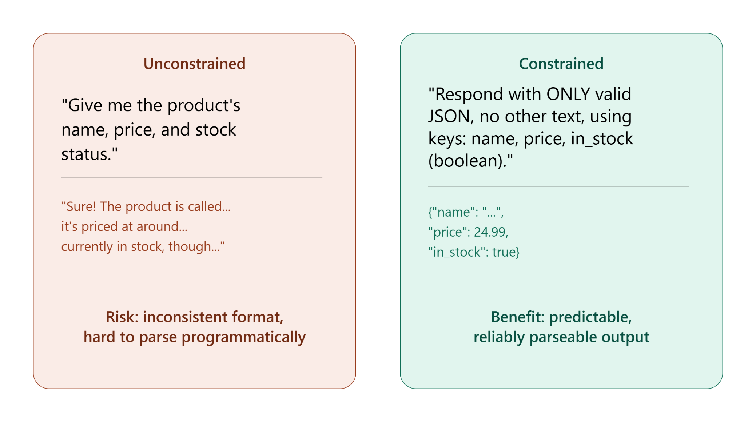
Constraints

Slide 31
Constraints and Quality
There exists a tradeoff between constraints and quality of output
Too few constraints:
Inconsistent output (format, tone, and/or content)
Hard-to-use output
Result in improper conclusions/output for given input
Too many / Overly rigid constraints:
Output that feels stilted
Force model to provide unnatural responses as compared to specific input
Overly complicate output for simple tasks

Slide 32
Instructions & Guidelines

Slide 33
Instructions and Guidelines
Instructions: direct, imperative statements telling the model what to do.
E.g. “summarize the following document”
Typically treated as requirements
Guidelines: softer, preference-oriented statements that shape how the model should approach a task
E.g. “prefer concise explanations where possible”
Doesn’t include strict pass/fail rules
Provide more flexibility than hard constraints
Models generally treat guidelines and instructions with different weight.
Direct, clear instructions and hard constraints are typically followed more reliably than soft preferences.

Slide 34
Instruction Types
System-level instructions:
Instructions set once for the entire conversation/session
Defines overall behavior, persona and rules for AI-powered feature
Might be set as meta-data feature for certain LLMs
Turn-level instructions:
Given as part of a specific request
Addresses specific instructions for a particular task

Slide 35
Instruction Management
Long and Complex instructions can cause inconsistent LLM outputs
Organizing instructions improves reliability:
Use clear delimiters of sections (headings, numbered lists, labeled blocks)
Place most important instructions prominently (first)
Avoid contradictory instructions within a prompt
Conflicts: When two instructions in the same prompt suggest different outputs
E.g. “be extremely detailed…keep it under two sentences”
The model must resolve the tension itself, often inconsistently
As prompts grow in complexity, short, single-purpose prompts rarely have organization problems
Real world prompts accumulate context, examples, constraints, persona instructions
Clear organization becomes essential to keeping the prompt understanding and debug-able

Slide 36
Interaction & Dialogue State

Slide 37
State
LLMs are stateless between requests.
A model doesn’t inherently “remember” previous messages in a conversation
Each time you send a message, the entire relevant conversation history is sent along with it
An application making a multi-turn conversation (e.g. back-and-forth with a chatbot) is responsible for tracking and re-sending the conversation history
Recall context window. The full history being sent grows with the context window
Eventually, this can exceed the model’s context window limit.
As a conversation approaches context limits, certain strategies may be used. Below are common strategies:
Truncation: dropping the oldest messages to make room for new ones
Summarization: condensing earlier parts of the conversation into a short summary that preserves key information
Selective retention: keeping certain important messages while dropping less relevant ones.

Slide 38
LLM Memory
Major LLM Players have certain features that are used, natively to “remember” chat context.
Claude:
Context Compaction: automatic summarization and updation of context as conversations approach configured token threshold.
ChatGPT:
ChatGPT uses a combination of “saved memory” – details a user explicitly ask ChatGPT to remember, and “chat history reference” which lets ChatGPT draw on information from past chats. Note that previously referenced chats likely use a form of selective retention
Gemini:
Context caching: storing of frequently reused context on the server
Large context windows: Up to 2 million tokens

Slide 39
Dialogue State
Dialogue State refers to the relevant information a conversation needs to “remember” to behave coherently
Things like: The user’s overall goal, decisions already made, facts already established, any preferences expressed earlier in the conversation
If you’re building an AI-powered feature with multi-turn interaction, decisions about what to retain, summarize, or drop as a conversation grows directly affect whether the experience feels coherent, or feels like the model has “forgotten” something.
Topic shifts within a conversation can affect output quality – older irrelevant context can impact new topic responses.

Slide 40
Fine-Tuning Conditioning

Slide 41
Fine-Tuning
Prompt types, examples, chain-of-thought, persona, constraints, instructions and dialogue state shape model behavior at the prompt level
Fine-tuning is a different, more durable approach to shaping behavior
Fine-tuning is the process of further training an existing, pre-trained model on a smaller, specific dataset
Fine-tuning also adjusts the model’s internal parameters (its weights) so that certain behaviors, styles or knowledge become built into the model itself.
Key distinction:
Prompt shapes behavior temporarily
Fine-tuning shapes behavior durably

Slide 42
Why Fine-tune?
Fine-tuning is a very expensive process (resources, time and cost)
The investment may be worth it in certain scenarios:
Highly repetitive, specialized tasks: If the same complex persona/instructions would need to be repeated in every request
Domain-specific knowledge/vocabulary: If domain-specific information is not well represented in the base model’s general training
Reducing prompt length and cost at scale: If a very long, structured prompt is required for consistent results
Fine-tuning is not always the right-choice. Most day-to-day tasks are faster and cheaper to complete with well engineered prompting

Slide 43
Fine-Tuning | High-level Overview
Define the objective clearly
You should answer the question “what specific behavior am I trying to instill, and why can’t prompting achieve it well enough?”
Collect and curate training data
A large dataset of examples demonstrating the exact desired behavior is required. This is typically the most labor-intensive step.
Clean and format data
Raw examples typically need to be structured into a specific format (based on the base model & training type). Additionally, duplicates, errors and inconsistencies should be removed.
Choose a base model
You don’t train a model from scratch, rather you start with a pre-existing, pre-trained model and adapt it.
Run the training process
Feed your curated training data through the training process. Typically requires specialized infrastructure (GPUs) or using a provider’s managed fine-tuning service.
Evaluate the result
Test the fine-tuned model on examples not used in the training, and check if the desired behavior has been achieved without unintended side effects. This often leads to repeated trainings (and additional curated data)
Deploy and monitor
Once deployed, the model should be monitored continuously for any gaps the evaluation didn’t catch.

